Slide 1
Workload measurement for pathologists in Ontario
F. Halwani, A. Halil, D. Banerjee
OAP Annual Meeting 2018

Slide 2
Notice of Non-Affiliation and Disclaimer
I am not affiliated, associated, authorized, endorsed by, or in any way officially connected with any commercial or governing entity

Slide 3
WHY?
For workforce planning (additional staff)
For job planning (scheduling)
For evidence in appraisal and revalidation (QA)
To ensure fair distribution of work amongst colleagues (fairness & well being)
For benchmarking against other departments
To reassure the public that resources are appropriate for a safe service
Ref: Royal College of Pathologists guidelines on staffing and workload for histopathology and cytopathology departments (4th ed).

Slide 4
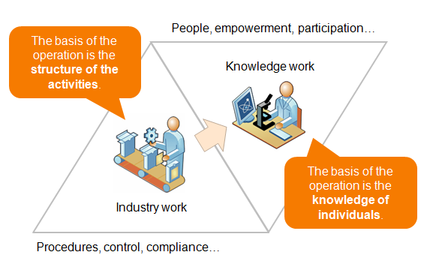
HOW?
The manual worker works with his or her hands and produces goods or services. In contrast, a knowledge worker works with his or her head, not hands, and produces ideas, knowledge, and information. - Peter Drucker (1966).

Slide 5
CAP (Canada)
Assigns different levels according to case complexity with more units allocated to more complex specimens.
In most cases, number of units changes according to number of blocks submitted.
In some cases, number of units changes according to number of fragments, cores or lesions.
Assigns additional units for additional work:
        Immunohistochemistry
        Special Stains
        Quality Assurance activities
        Frozen sections

Slide 6
W2Q (Ontario)
Based on the American CPT, but aligned to the OHIP SOB
Assigns different levels according to case complexity
Does not assign units for extra blocks or levels
Does not count fragments, cores or lesions
Assigns additional units for routine/additional work:
        Immunohistochemistry
        Special Stains
        Quality Assurance activities

Slide 7
RCP (UK)
Accounts for case complexity with more units allocated to more complex specimens.
Combines some specimens (GI, prostate) into groups (1, 2-5, > 5)
Does not assign additional units for extra blocks/slides, immunohistochemistry, quality assurance activities (except EM)
No codes for Neuropath

Slide 8
CPT (USA)
Assigns different levels according to case complexity with more units allocated to more complex specimens.
Does not assign additional units for extra blocks/slides
Assigns additional units for routine/additional work, one per specimen, no repeats:
        Immunohistochemistry
        Special Stains
Does not assign units for autopsy or quality assurance activities
Does not define a standard value for FTE

Slide 9
Summary
 | CAP | W2Q | RCP | CPT
Specimen Type | ++ | ++ | ++ | ++
Blocks | ++ | – | – | –
Fragments | ++ | – | – | –
Lesions | ++ | – | – | –
Levels | ++ | – | – | –
SS | + | ++ | – | +
IHC | + | ++ | – | +
Molecular | ++ | ++ | – | ++
Cell Block | – | ++ | – | ++
Autopsy | ++ | ++ | + | +
Neuropath | ++ | ++ | – | ++
Gross Only | ++ | ++ | – | ++
IF Only | ++ | ++ | – | ++
QAA | ++ | ++ | – | –
Annual Units per FTE | 7,560 | 7,500 | 11,340 | 6,016

Slide 10
Power J
Developed in-house
Automates 4 workload measurement schemes
Reads PowerPath© accession codes, specimen templates, number of blocks, number of fragments, pathologists’ orders for IHC, SS, EM, some QA activities
Writes summary data to a separate database
Creates on-the-fly summary reports using SQL
Data audited and validated by Dr. A. Halil, QCH

Slide 11
What we aren’t/can’t capturing?
Frozen section pathologist
Fragmented core biopsies
Molecular tests
Bone marrow biopsies and aspirates at TOH
Subspecialty of generic specimen codes (BXCA, MASS, FSEC)
Systematic QA activities not related to an individual case
Academic activities

Slide 12
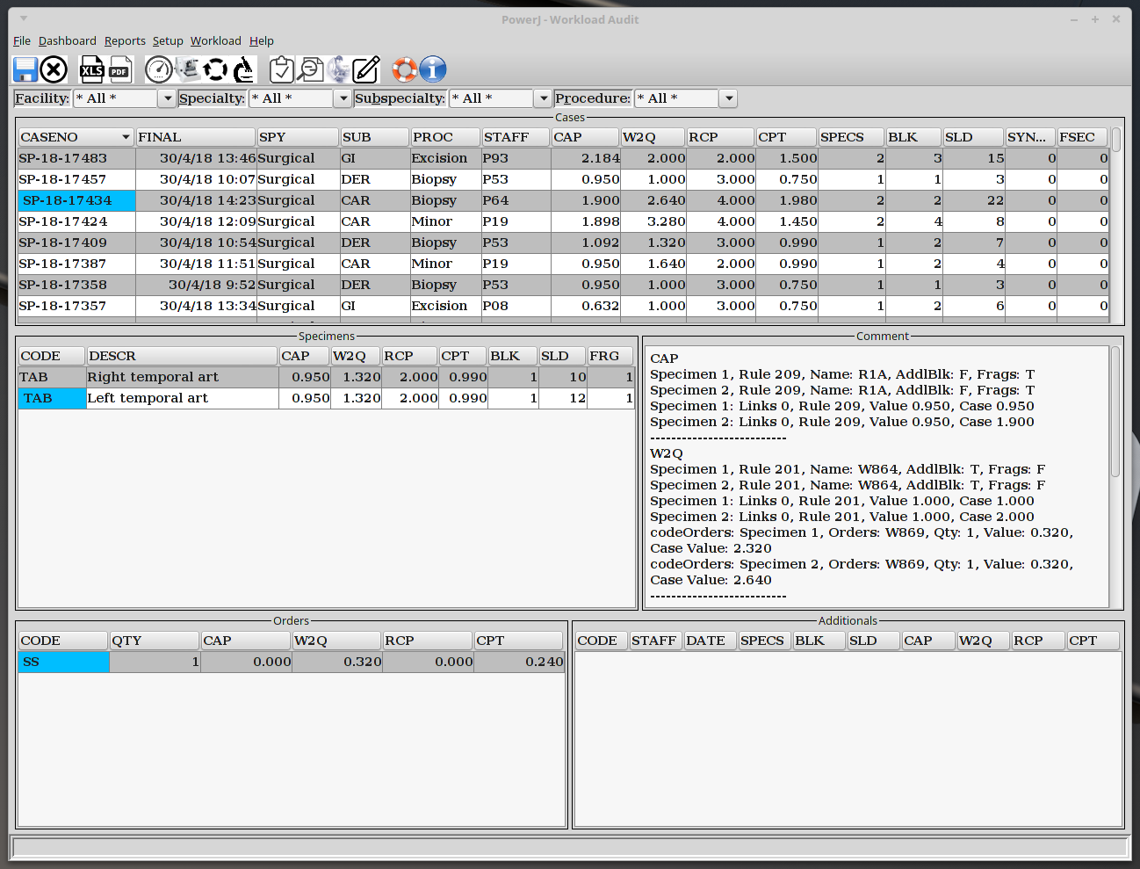

Slide 13
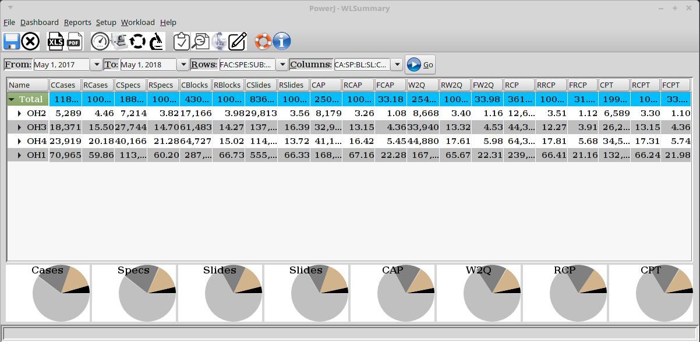
Workload Report

Slide 14
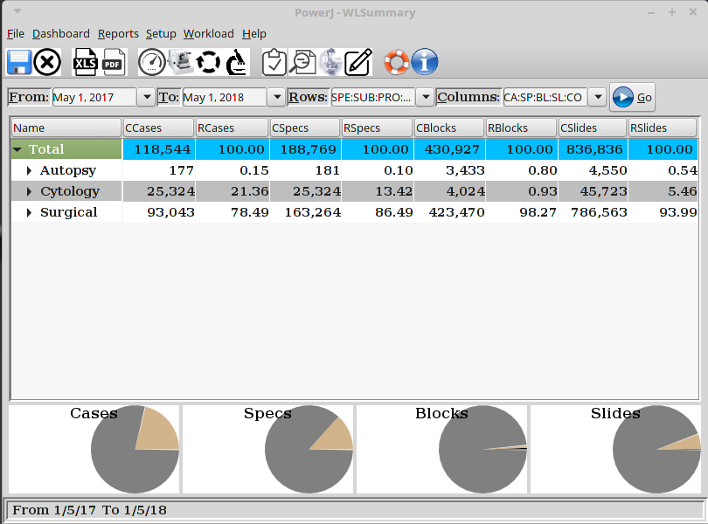
Breakdown of Cases by Specialty

Slide 15
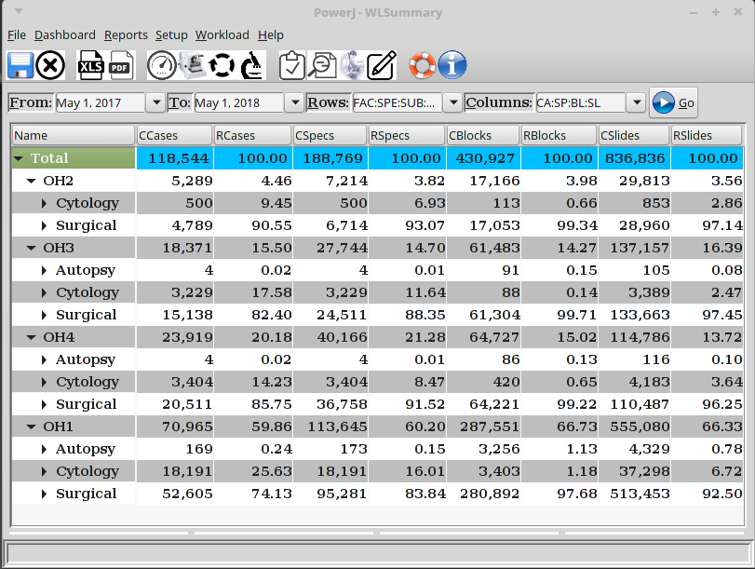
Breakdown of Cases by Hospital & Specialty

Slide 16
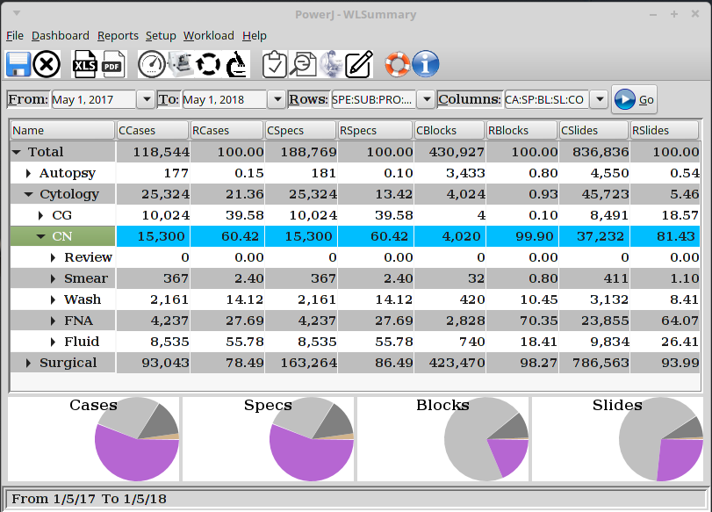
Cytology Gyne (CG) vs Non-Gyne (CN)

Slide 17
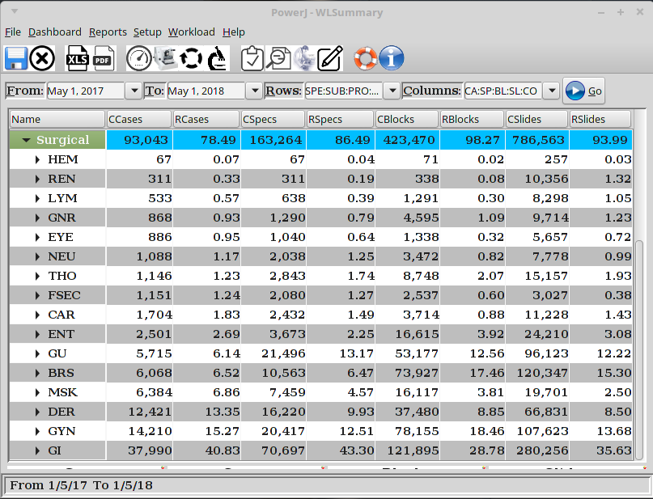
Surgical Path Sub-specialties

Slide 18
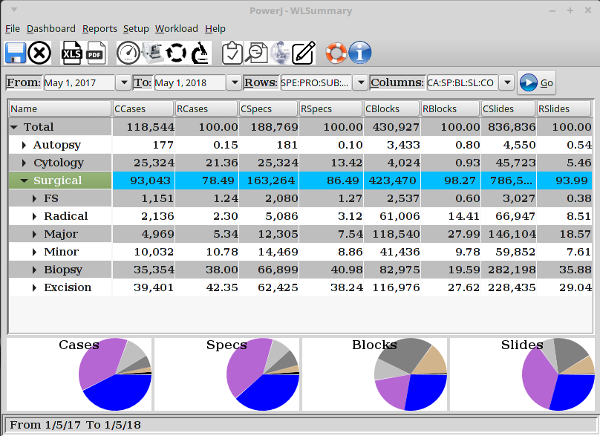
Surgical Path Procedures

Slide 19
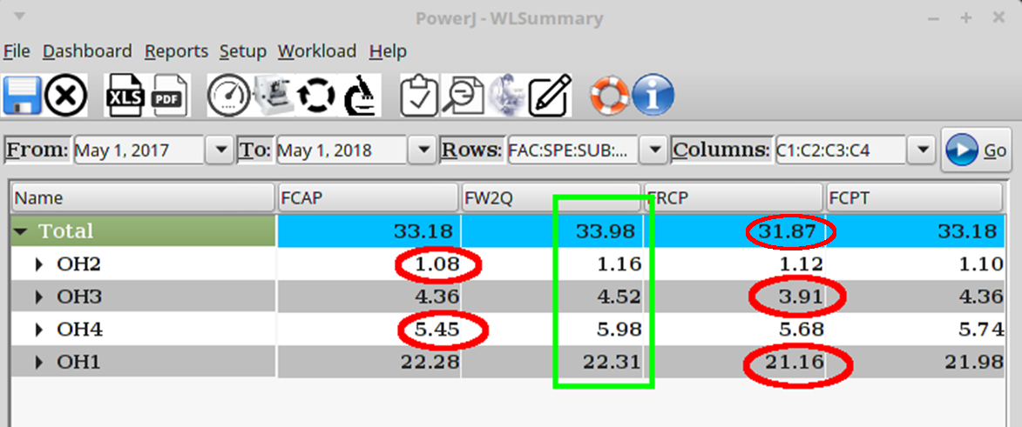
FTE Total and Breakdown by Hospital

Slide 20
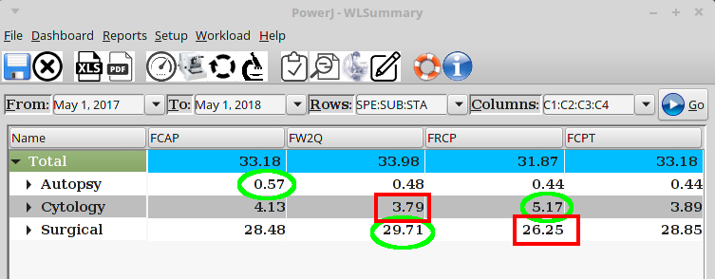
FTE by Specialty

Slide 21
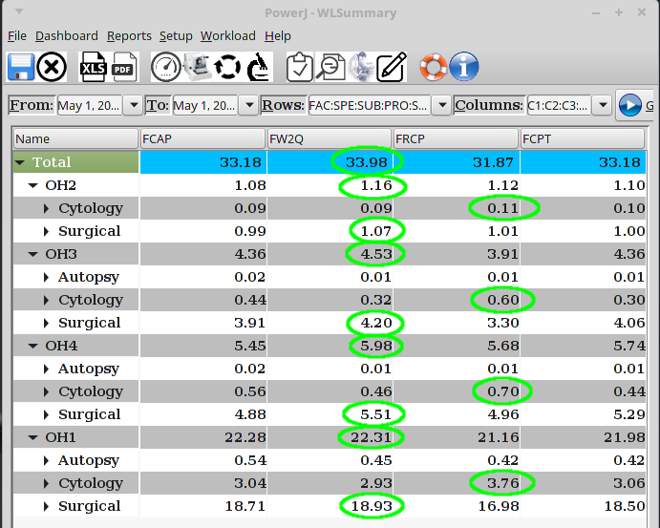
FTE by Hospital and Specialty

Slide 22
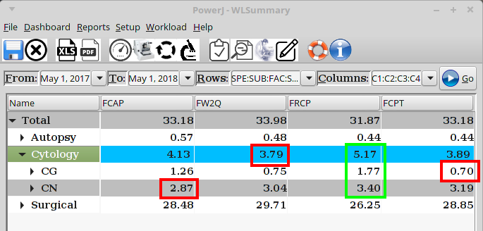
FTE Cytology Gyne (CG) vs Non-Gyne (CN)

Slide 23
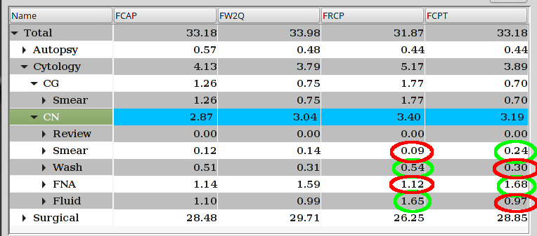
Cytology Workload by Procedure

Slide 24
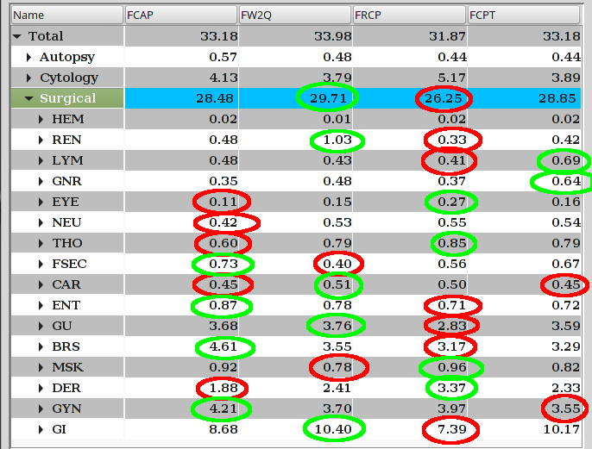
Surgical Path Sub-specialities

Slide 25
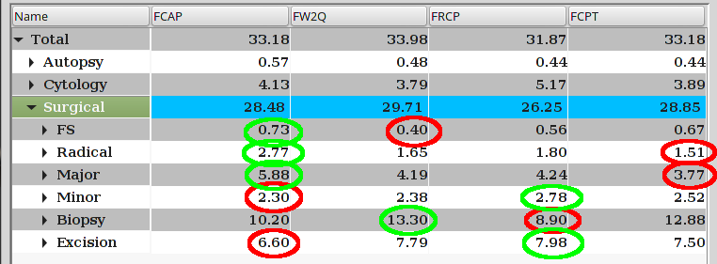
Surgical Pathology Workload by Procedure

Slide 26
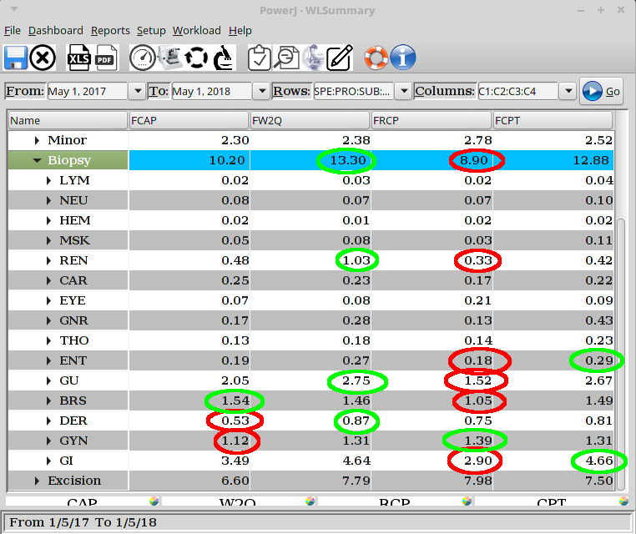
Surgical Pathology Biopsy Workload

Slide 27
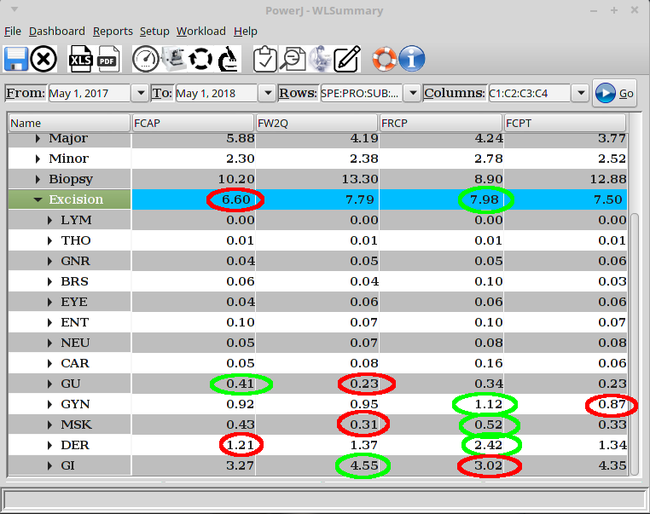
Surgical Pathology Excisions Workload

Slide 28
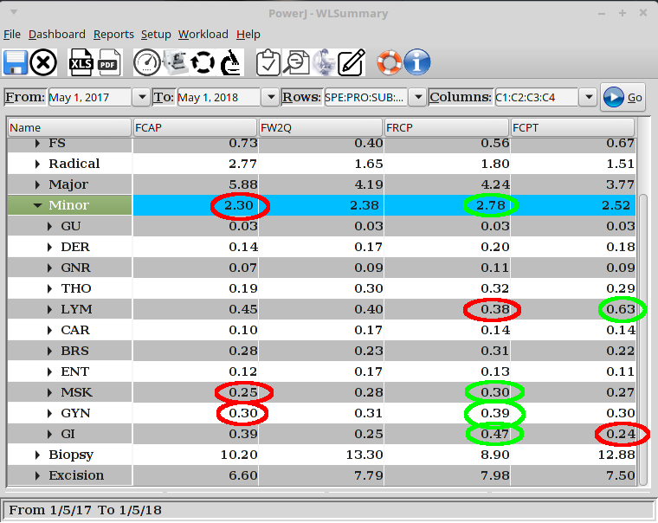
Surgical Pathology Minor Resections

Slide 29
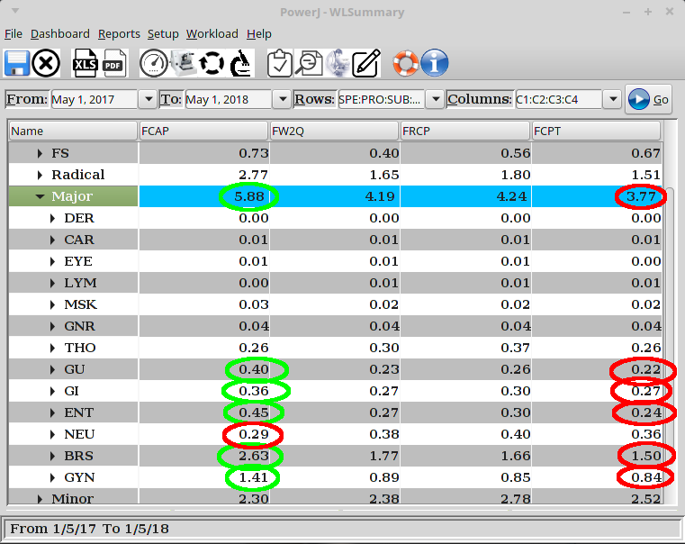
Surgical Pathology Major Resections

Slide 30
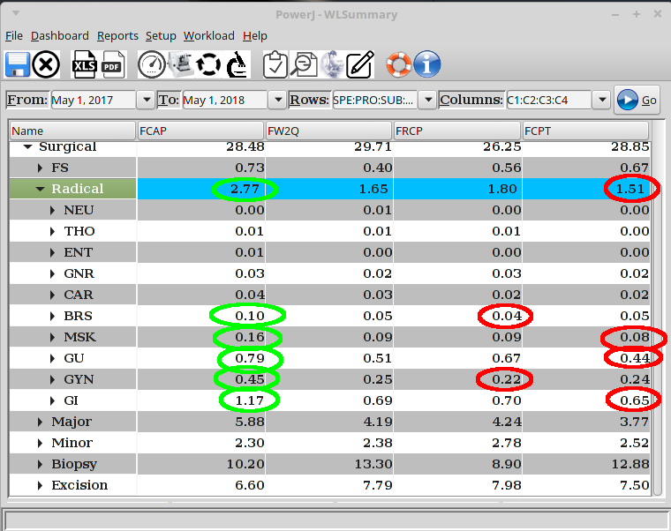
Surgical Pathology Radical Resections

Slide 31
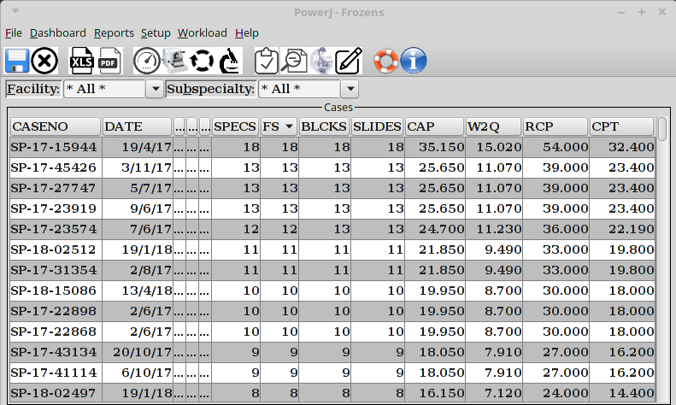
Frozen Sections

Slide 32
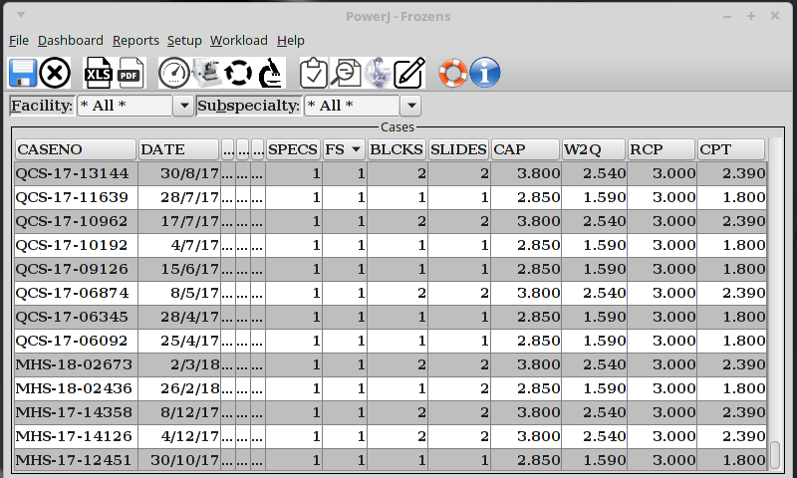
Frozen Sections

Slide 33
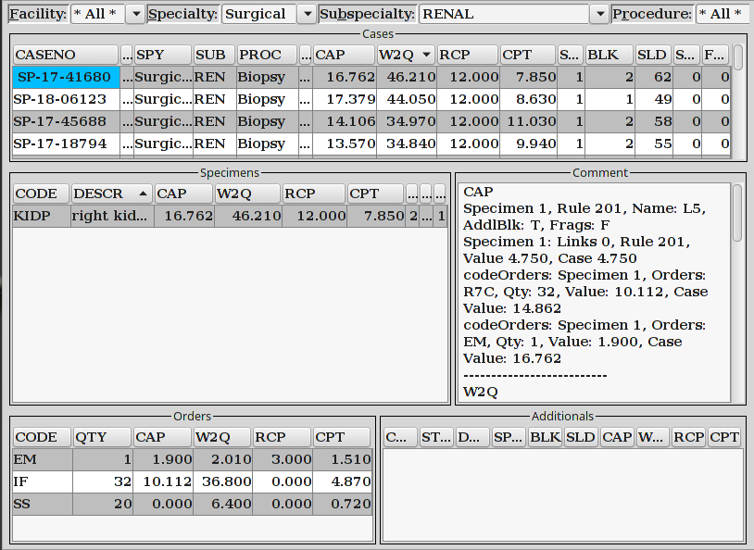
Renal Biopsies

Slide 34
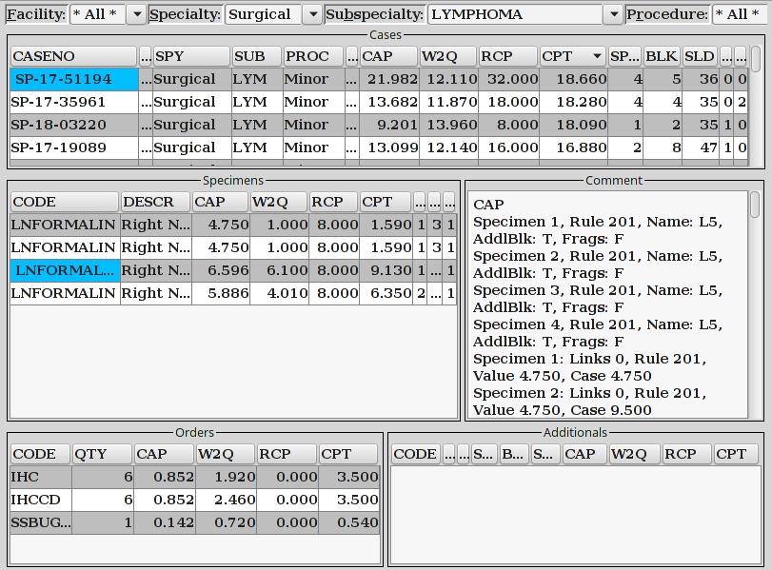
Lymphoma

Slide 35
Workload Units for Additional Orders
(absolute & relative)
 | Qty | CAP | W2Q | RCP | CPT
IHC | 68,475 (8.2) | 12,553 (5.0) | 32,968 (12.9) | – | 39,454 (19.8)
SS | 17,202 (2.0) | 1,176 (0.5) | 7,380 (2.9) | – | 4,201 (2.1)
IF | 6,302 (0.8) | 1,991 (0.8) | 7,247 (2.8) | – | 2,354 (1.2)
EM | 426 (0.1) | 781 (0.3) | 826 (0.3) | 1,233 (0.3) | 621 (0.3)

Slide 36
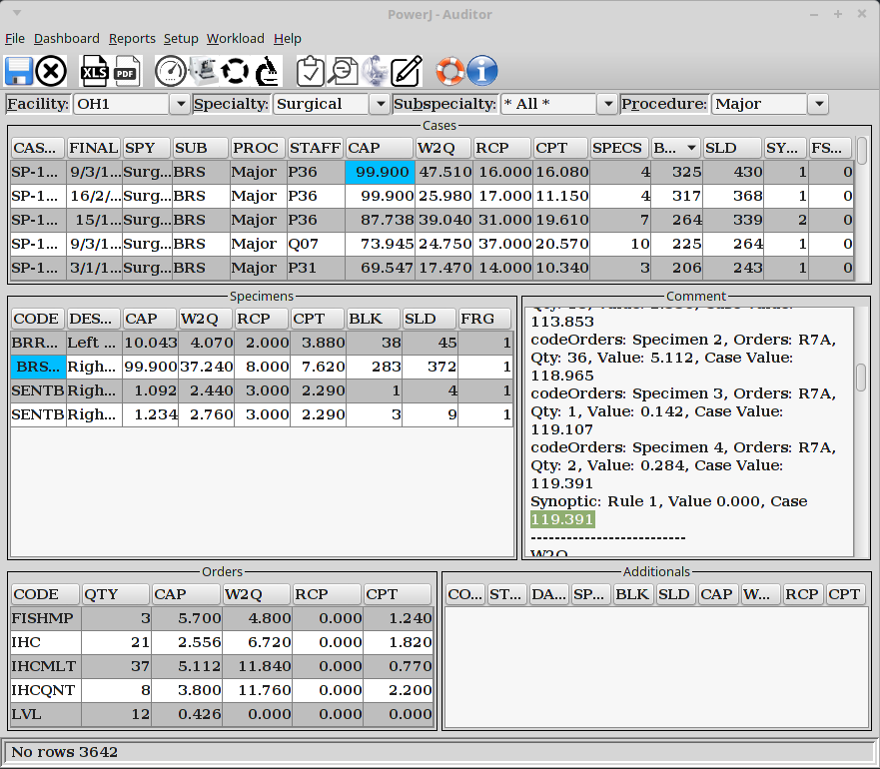
Number of Blocks

Slide 37
Complexity Defined by 1 System
 | CAP | W2Q | RCP | CPT
GI | 5 | – | 17 | 11
GYN | 9 | 5 | 2 | 5
Breast | 57 | 8 | 1 | 2
GU | 5 | – | 21 | 3
Derm | – | – | 4 | –
MSK | 2 | – | 1 | 2
ENT | 1 | – | 5 | –
Thoracic | 1 | – | 5 | 4
Renal | – | 78 | – | –
Neuro | – | – | – | 6
Cardiac | – | – | 1 | 2
Eye | – | 1 | 1 | –
General | – | – | 5 | 2
Total | 80 | 92 | 63 | 37
Complex cases are defined as higher than a full autopsy

Slide 38
Complexity Defined by 2 Systems
 | CAP/W2Q | CAP/RCP | CAP/CPT | W2Q/RCP | W2Q/CPT | RCP/CPT
GI | – | – | – | – | 1 | –
GYN | – | – | – | – | 1 | 2
Breast | 6 | 1 | – | 1 | 4 | –
GU | – | 4 | – | 1 | – | –
Derm | – | – | – | – | – | 1
MSK | – | – | – | – | – | –
ENT | – | – | – | – | 1 | –
Thoracic | – | – | – | – | 1 | –
Renal | – | – | – | – | – | –
Neuro | – | – | – | – | 1 | –
Cardiac | – | – | – | – | – | –
Eye | – | – | – | – | – | –
General | – | – | – | – | – | –
Total | 6 | 5 | 0 | 2 | 9 | 3
Complex cases are defined as higher than a full autopsy

Slide 39
Complexity Defined by 3 or 4 Systems
 | A/B/C | A/B/D | A/C/D | B/C/D | A/B/C/D
GI | – | – | – | 4 | 1
GYN | – | – | – | 3 | –
Breast | – | 2 | 1 | 1 | 1
GU | – | – | – | 3 | 2
Derm | – | – | – | 3 | –
MSK | – | – | – | – | –
ENT | – | – | – | – | –
Thoracic | – | – | – | – | –
Renal | – | – | – | – | –
Neuro | – | – | – | – | –
Cardiac | – | – | – | – | –
Eye | – | – | – | – | –
General | – | – | – | – | –
Total | 0 | 2 | 1 | 14 | 4
Legend: CAP (A), W2Q (B), RCP (C), CPT (D)

Slide 40
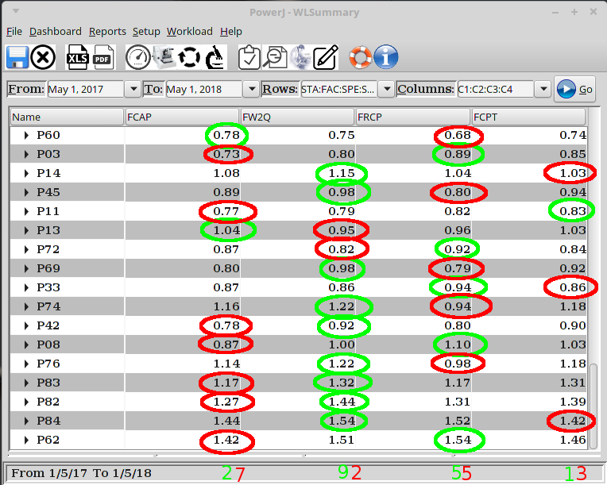
Top 20 Pathologists

Slide 41
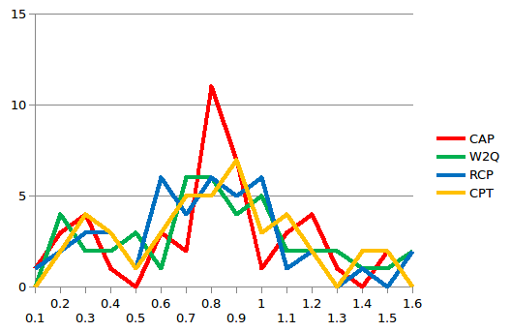
FTE’s per Pathologist
FTE | CAP | W2Q | RCP | CPT
0.1 | 1 | 0 | 1 | 0
0.2 | 3 | 4 | 2 | 2
0.3 | 4 | 2 | 3 | 4
0.4 | 1 | 2 | 3 | 3
0.5 | 0 | 3 | 1 | 1
0.6 | 3 | 1 | 6 | 3
0.7 | 2 | 6 | 4 | 5
0.8 | 11 | 6 | 6 | 5
0.9 | 7 | 4 | 5 | 7
1.0 | 1 | 5 | 6 | 3
1.1 | 3 | 2 | 1 | 4
1.2 | 4 | 2 | 2 | 2
1.3 | 1 | 2 | 0 | 0
1.4 | 0 | 1 | 1 | 2
1.5 | 2 | 1 | 0 | 2
1.6 | 0 | 2 | 2 | 0
Notes:
41

Slide 42
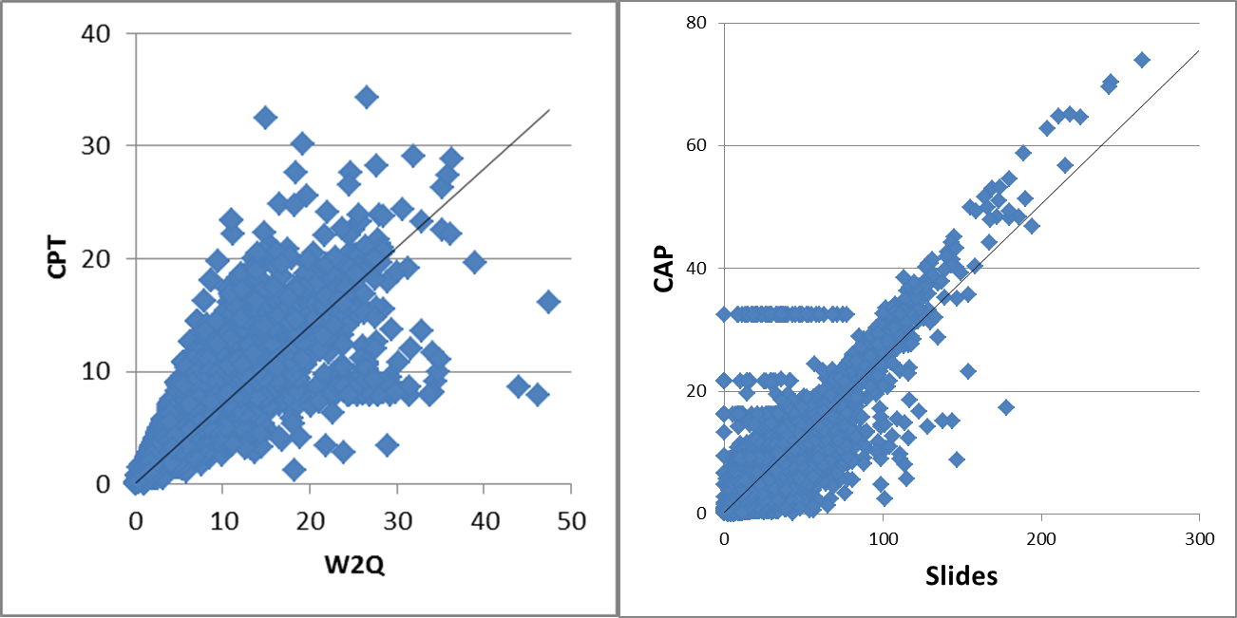
Statistical Correlation Analysis
Linear Regression | CAP/Slides | CAP/W2Q | CAP/RCP | CAP/CPT | W2Q/RCP | W2Q/CPT | RCP/CPT
Multiple R | 0.892 | 0.773 | 0.775 | 0.736 | 0.761 | 0.915 | 0.739
R Square | 0.796 | 0.598 | 0.601 | 0.542 | 0.580 | 0.837 | 0.546
Standard Error | 1.429 | 2.019 | 2.010 | 2.154 | 1.832 | 1.139 | 2.313

Slide 43
Summary
 | CAP | W2Q | RCP | CPT | AVG
GI | 8.7 | 10.4 | 7.4 | 10.2 | 9.2
GYN | 4.2 | 3.7 | 4.0 | 3.6 | 3.9
Breast | 4.6 | 3.6 | 3.2 | 3.3 | 3.7
GU | 3.7 | 3.8 | 2.8 | 3.6 | 3.5
Derm | 1.9 | 2.4 | 3.4 | 2.3 | 2.5
MSK | 0.9 | 0.8 | 1.0 | 0.8 | 0.9
ENT | 0.9 | 0.8 | 0.7 | 0.7 | 0.8
Thoracic | 0.6 | 0.8 | 0.9 | 0.8 | 0.8
FS | 0.7 | 0.4 | 0.6 | 0.7 | 0.6
Renal | 0.5 | 1.0 | 0.3 | 0.4 | 0.6
Neuro | 0.4 | 0.5 | 0.6 | 0.5 | 0.5
Lymphoma | 0.5 | 0.4 | 0.4 | 0.7 | 0.5
Cardiac | 0.5 | 0.5 | 0.5 | 0.5 | 0.5
General | 0.4 | 0.5 | 0.4 | 0.6 | 0.5
CG | 1.3 | 0.8 | 1.8 | 0.7 | 1.1
CN | 2.9 | 3.0 | 3.4 | 3.2 | 3.1
Autopsy | 0.6 | 0.5 | 0.4 | 0.4 | 0.5
Total | 33.2 | 34.0 | 31.9 | 33.2 | 33.1

Slide 44
Takeaway
PowerJ is a benchmarking tool that provides you with objective data about workload
Every tool has limitations
The data provided by PowerJ is a starting point for discussions about workload – it is not the end point!
PowerJ is an open-source software; the source code, data, and this presentation are available on GitHub® https://github.com/fhalwani/PowerJ

Slide 45
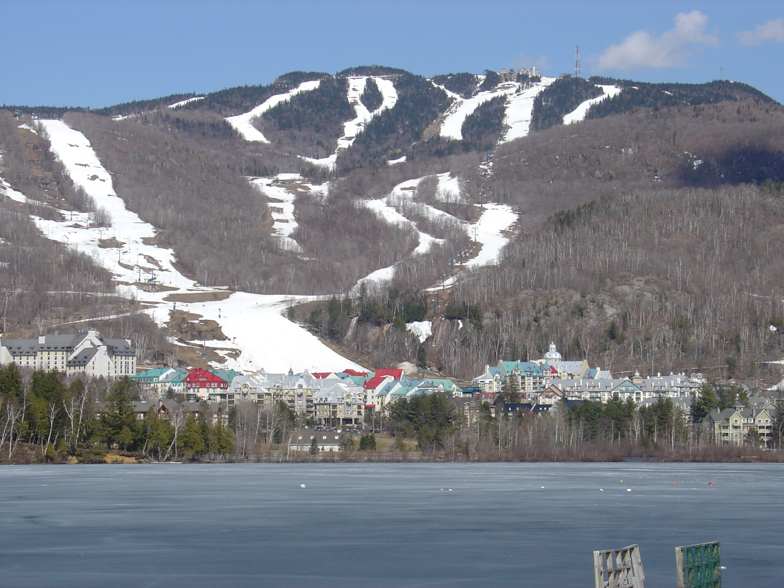
Thank You

